Slide 1
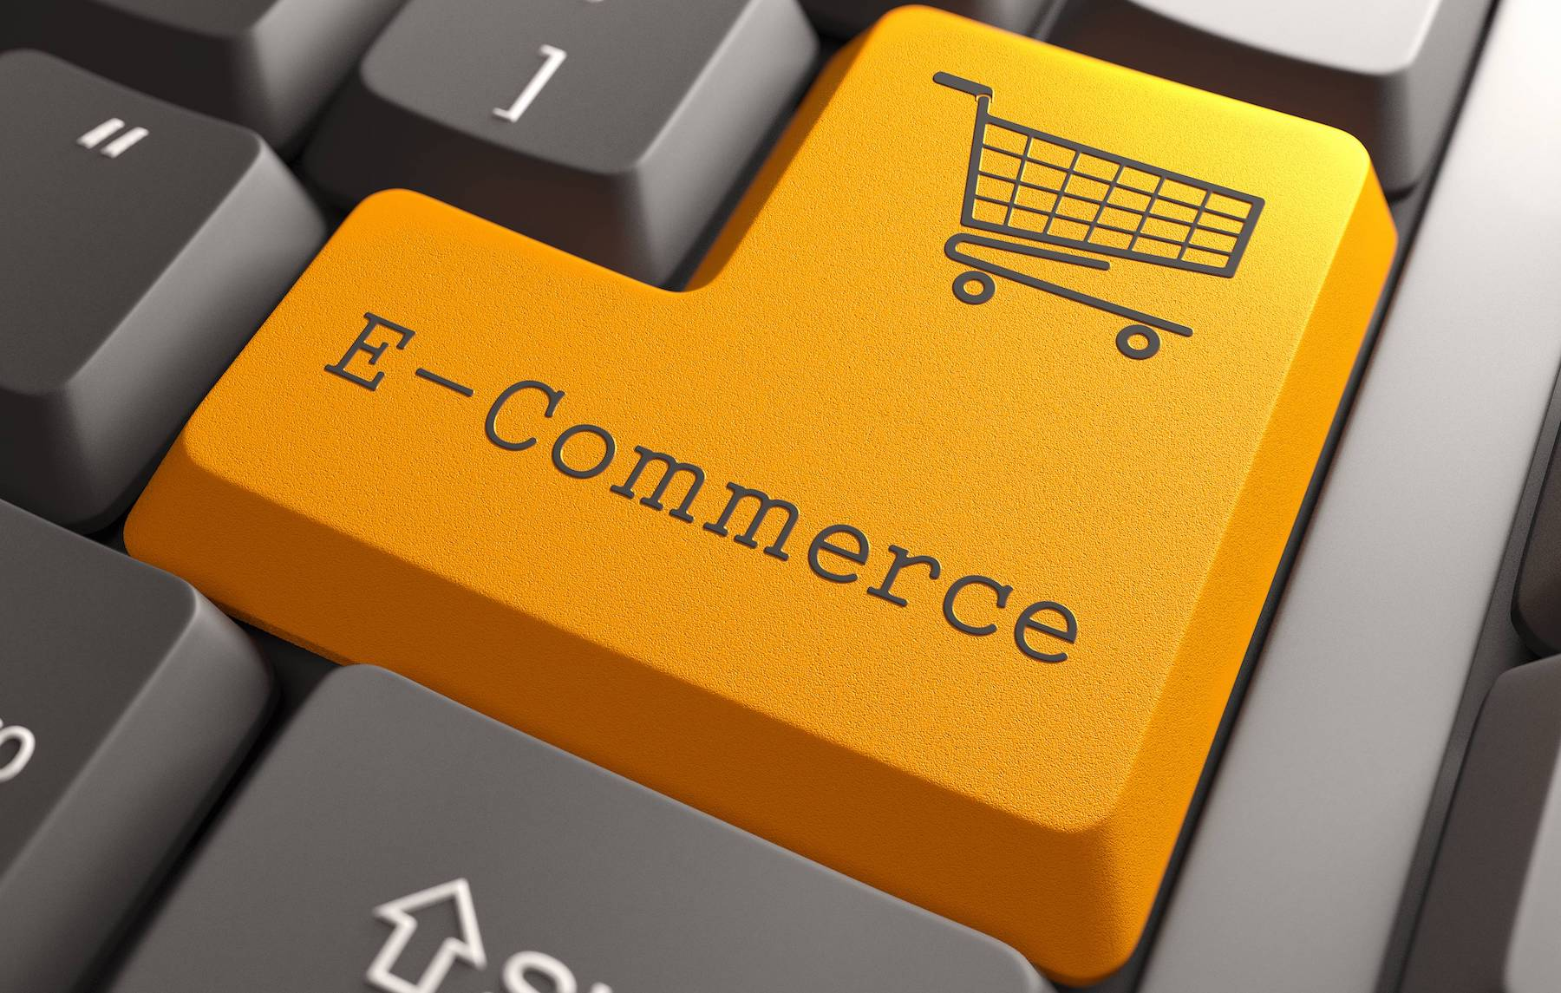
About Me
Nisha Abid Ali Sayed
Roll No -321
R D & S H National College

Slide 2
E-Commerce
About Me

Slide 3
Commonly known as Electronic Commerce.
“ It consist of buying selling goods and services over an electronic systems Such as the internet and other computer networks.”
What is E-Commerce
About Me

Slide 4
Ecommerce, also known as electronic commerce or internet commerce, refers to the buying and selling of goods or services using the internet, and the transfer of money and data to execute these transactions. Ecommerce is often used to refer to the sale of physical products online, but it can also describe any kind of commercial transaction that is facilitated through the internet.
Definition
What is E-Commerce

Slide 5
Features of E-Commerce
Ubiquity
Global Reach
Richness
Universal Standards
Features
Definition
Interactivity
Information Density
Social Technology
Personalization

Slide 6
Eight Unique Components of E-commerce
Ubiquity is defined as being something that occurs everywhere. Ever since the inception of the internet, its user base has grown exponentially, and with it, E-commerce has blossomed. Libraries, homes, businesses, people’s personal cell phones and even airplanes, all have access to the internet.
Global Reach refers to the previously smaller, more contained marketplace (where we traditionally did business before the internet – brick and mortar stores) turning outward and morphing into a “market space”. This new market space is online, and encompasses every single type of business you can imagine, from Amazon which sells a little bit of everything, to much more focused businesses such as Lighting manufacturers.
Components
Features
Universal Standards, which is fairly easy to understand. The internet has its own universally accepted standards of how information is presented.
Richness is simply refers to the fact that there are now video ads, audio messages, and even interactive text options, on many retail sites.

Slide 7
Continue Components of
E-commerce
Information Denseness is accessing your competitor’s, manufacturer’s, and delivery service’s information, which allows you to save on information processing, storage and communication costs.
Personalization, this implies that not only will you receive your products in a timely manner, but that they will be exactly what you want. There is a growing trend now of customization in many different businesses.
Components Cont.
Components
Social technology has changed E-Commerce in many ways. It has allowed people all over the world to start networking and share their interests, which in turn has allowed companies to more selectively target their customer bases.
Interactivity is something I really like, because it makes me feel like I’m a valued customer. There is nothing more frustrating than going into a store to find something you need, and not getting the assistance you feel you deserve.

Slide 8
Six Traditional Types of Ecommerce Business Models
Consumer-to-Consumer (C2C)
Business-to-Consumer (B2C)
Consumer-to-Business (C2B)
Types
Components Cont.
Business-to-Business (B2B)
Consumer-to-Administration (C2A)
Business-to-Administration (B2A)

Slide 9
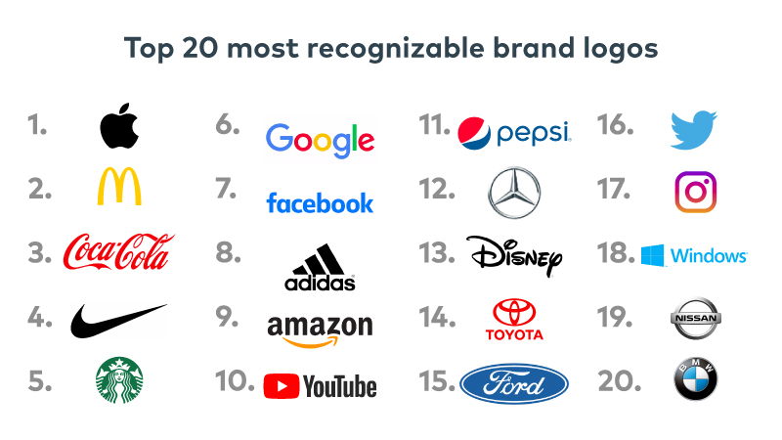
Major Brands Example
Major Brands
Types

Slide 10
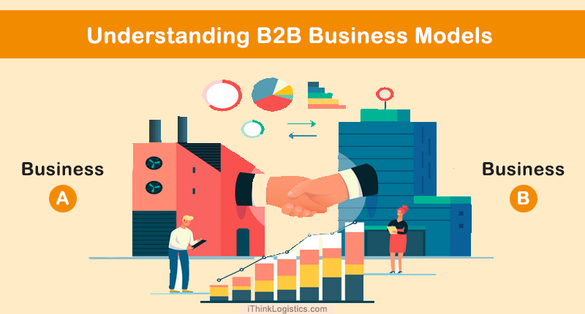
Business-to-Business (B2B)
What Is Business-to-Business (B2B)?
Business-to-business (B2B), also called B-to-B, is a form of transaction between businesses, such as one involving a manufacturer and wholesaler, or a wholesaler and a retailer. Business-to-business refers to business that is conducted between companies, rather than between a company and individual consumer. Business-to-business stands in contrast to business-to-consumer (B2C) and business-to-government (B2G) transactions.
B2B
Major Brands

Slide 11
Disadvantages of Business-to-Business (B2B)
Limited Market
Compared to the B2C model, this type of business has a limited market base as it deals with transactions between businesses. This makes it a bit of a risky venture for small and medium E-Commerce businesses.
Lengthy Decision
Here, the majority of the purchase decisions involve a lengthy process as there are two businesses involved. The process may involve dependence on multiple stakeholders and decision makers.
Inverted Structure
Compared to the other models, consumers have more decision making power than sellers in the B2B business model. They may demand customizations, impose specifications and try to lower price rates.
Disadvantage of B2B
B2B

Slide 12
Advantages of Business-to-Business (B2B)
Market Predictability
Compared to the other business strategies, the B2B E-Commerce business model has more market stability. B2B sectors grow gradually and can adapt to various complex market conditions. This helps to strengthen the online presence and business opportunities and get more potential clients and resellers.
Better Sales
An improved supply chain management process along with a collaborative approach increase customer loyalty in the B2B E-Commerce business model. This, in turn, leads to improved sales. It helps businesses to showcase product recommendations and unlock effective upselling and cross-selling opportunities.
Lower Costs
Due to an effective supply chain management process, this online business model leads to lower costs for businesses. In most cases, the work is done through automation that eradicates the chances of errors and undue expenditure.
Advantages of B2B
Disadvantage of B2B

Slide 13
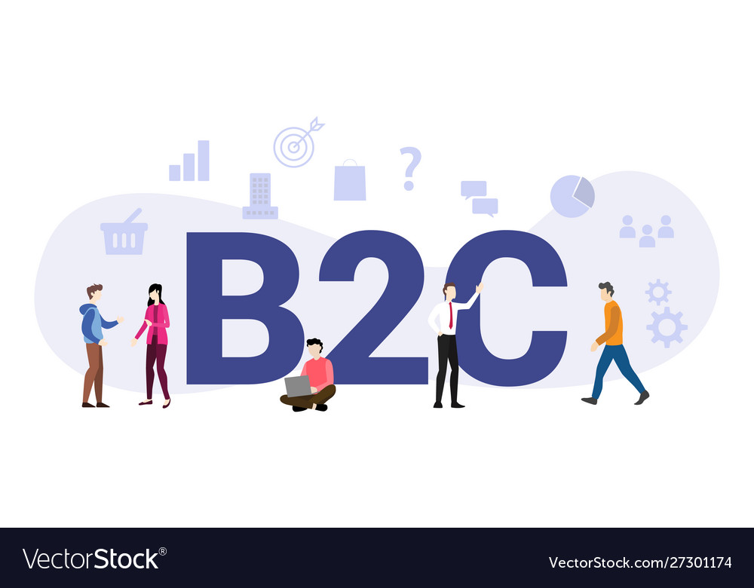
Business-to-Customer (B2C)
What Is Business-to-Consumer (B2C)?
The term business-to-consumer (B2C) refers to the process of selling products and services directly between a business and consumers who are the end-users of its products or services. Most companies that sell directly to consumers can be referred to as B2C companies.
B2C
Advantages of B2B

Slide 14
Advantages of Business-to-Customer (B2C)
You can reach a huge audience worldwide.
It is easy to convert visitors into customers.
You can readily set up the online store using top E-Commerce
platforms like Shopify and Magento.
Small and mid-size businesses can grow quickly through this model.
Advantages of B2C
B2C

Slide 15
Disadvantages of Business-to-Customer (B2C)
A lot of struggle to survive and thrive in a cut-throat race.
Website needs to be capable of handling multiple orders at once.
Low value of orders keep the margin lower than B2B website.
It is difficult to get repetitive customers and need to invest more in online marketing.
Finally, let’s discuss the combination of these two concepts- a unified Magento 2 website.
Disadvantage of B2C
Advantages of B2C

Slide 16
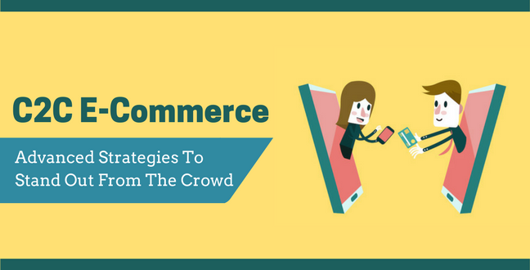
Customer-to-Customer (C2C)
What Is Customer to Customer (C2C)?
Customer to customer (C2C) is a business model whereby customers can trade with each other, typically in an online environment. Two implementations of C2C markets are auctions and classified advertisements. C2C marketing has soared in popularity with the arrival of the Internet and companies such as eBay.
C2C
Disadvantage of B2C

Slide 17
Advantages of Customer-to-Customer (C2C)
It is always available so that consumers can have access to whenever they feel like shopping.
There is regular updating of the website.
Consumers selling products to other consumers benefit from the higher profitability that result from selling directly to one another.
There is a low transaction cost; sellers can post their goods over the internet at a cheaper rate far better than higher price of renting a space in a store.
Customer can directly contact sellers and do without an intermediary.
Advantages of C2C
C2C

Slide 18
Disadvantages of Customer-to-Customer (C2C)
Payment made has no guarantee.
There could be theft as scammers might try to create their website with names of some famous C2C websites such as eBay to attract customers.
There is lack of controlling quality of the products.
Disadvantage of C2C
Advantages of C2C

Slide 19
Conclusion
Payment made has no guarantee.
There could be theft as scammers might try to create their website with names of some famous C2C websites such as eBay to attract customers.
The.
Conclusion
Disadvantage of C2C

Slide 20
Reference
TYBcom Computer Systems and Applications Textbook.
http://wiki.media.org.E-Commerce-Overwiev-Major-categories
http://www.shopping online.com
Google Images.
Reference
Conclusion

Slide 21
Acknowledgement
I would like to thanks of gratitude to my computer professor “Milind Kulkarni” for their guidance and support in completing my project.
I would also like to thanks my Principal madam “Dr. Neha Jagtiani” for providing all required facilities.
Acknowledgement
Reference

